Slide 1
E-Commerce Website for Automotive Parts
Name: Sateeswarbabu Katem (Enrollment No :EBEON0322571885)
Name : Jishnu Nambiar (Enrollment No : EBEON0322578300)
Name :- Sudhir Kumbhar (Enrollment No : EBEON0322584185)
Name: Ranjini Devi.R (Enrollment No : EBEON0322579232)
Name: Sanjai.S (Enrollment No : EBEON0322574368)
Guided by :
Mr. Vardharajan

Slide 2
Software and Hardware Requirements
Software Requirements
Eclipse IDE and STS IDE
Programming language- Java, Springboot.
JDK 17
Frontend - HTML, CSS, Bootstrap,JavaScript
Database - MySQL
Hardware Requirements
Processor – Intel core-I5
Speed - 1.8GHz
RAM - 4GB (minimum)
Hard disk- 50GB

Slide 3
E-Commerce Website for Automotive Parts
Modules:
Homepage
Login and Registration
Shop
Cart
Payment
Admin Module
Chatbot

Slide 4
E-Commerce Website for Automotive Parts
Modules and Submodules
Cart
Adding And Removing The Products
Calculating The Total Cart Amount
To Store Billing/Shipping Address In Database
Payment GateWay Integration
Connecting And Passing Cart Sum To Razorpay Payment Gateway
Created Order Details Storing In Database As Status=Created
Updating Order Details In Database As Status=Paid,After Payment

Slide 5
Continued...
Goal of module:
User Can Add Products to Cart From Shop page and Remove Products from Cart ,user can fill the shipping address details and movie to payment page.
Payment page the total amount to be paid is shown to user, where user can pay with any kind of payment method and payment id,order id as shown to user as alert message after payment success and redirected to home page.

Slide 6

Cart Page (1st Module)
Definition:
Cart Page Where user can add/remove products and it allows user to checkout in one go.
Sub module details :
By Cart Method size and total amount of the products is shown.
Shipping Address is Stored in database while proceeding to checkout.
DataBase Shipping Address
Id | Address | State | City | Pin
1 | 15-1-68-1,Shivaji Nagar,c.t.m. road | AndhraPradesh | Madanapalle | 517325

Slide 7
Module Interconnection details :
AddToCart
Products
CheckOut
Cart
Shipping Address
Pay
Total Cart Amount To Payment

Slide 8
Payment Page (2nd Module)
What is Payment Gateway API?
Payment Gateway API operates to integrate a payment solution with existing application,such as connecting a bussiness’s checkout to the payment system.
Razorpay Payment Integration
User Place an order by click Pay Button.
creating an order on our server.
Passing Order id to CheckOut.
Razorpay authenticates the payment
Capturing the payment completion.

Slide 9
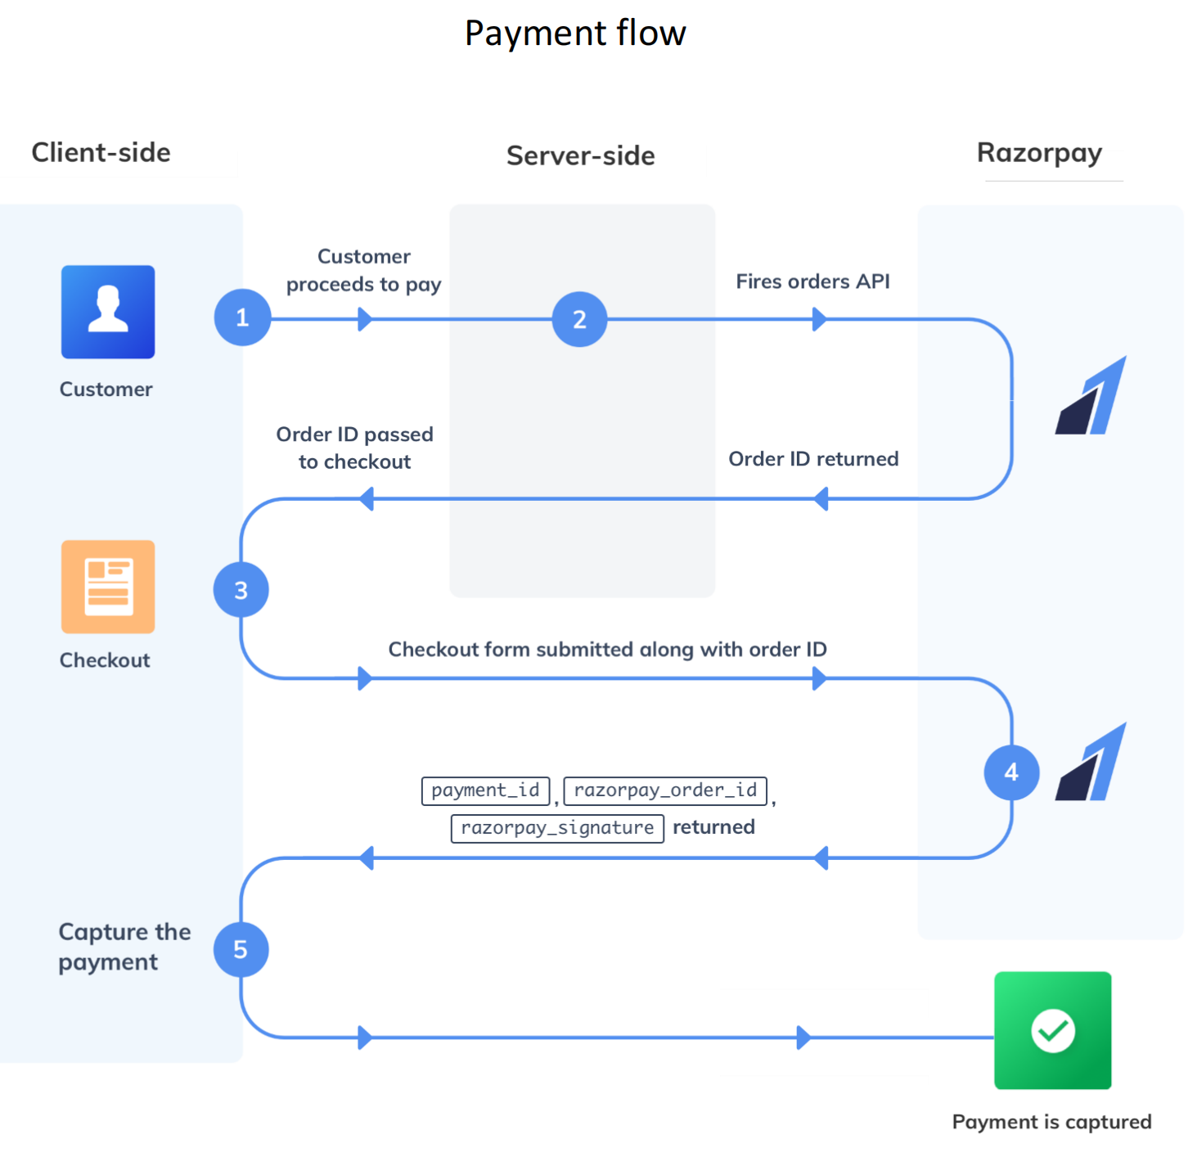

Slide 10
Continued...
Storing Order details while creating.
Updating Order details After Payment.
My_order_id | amount | Order_id | Payment_id | receipt | status
1 | 100 | Order_K2jBGSr4fGtHBa | NULL | Order_rcptid_11 | created
My_order_id | amount | Order_id | Payment_id | receipt | status
1 | 100 | Order_K2jBGSr4fGtHBa | Pay_K2qWP8bLt5xLsM | Order_rcptid_11 | Paid

Slide 11
Project overview
.
Admin
User Details
Add Category
Login
Add Product
Logout
Homepage
Shop
Chatbot
Payment
View Product
Add To Cart
Checkout

Slide 12
Tech architecture
Data JPA Security
Oauth2-Client
Thymeleaf
DevTools
Web
HTML
CSS
JavaScript
BootStrap
Java
SpringBoot
Hibernate
concepts
SpringBoot
Browser
FrontEnd
BackEnd
Hibernate
MySQL
Object Persistence
Mapping with POJO
Database Connection
DDL
DML
DCL
TCL

Slide 13
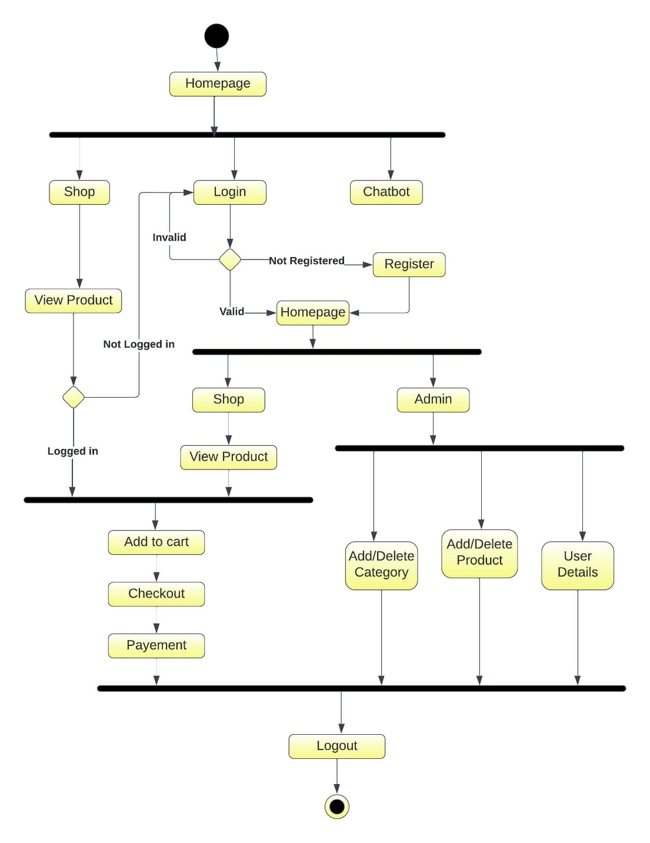
Activity diagram

Slide 14
Challenging issues
Build Failure Because of Version different.
Proper Project File Structure issue
jpaRepository parameters issue
Thymleaf reference is not able to pass to javascript method
Backend value passing from one table to another table.

Slide 15
Testing
Module | Expected Result | Pass/Fail
Cart | Without filling address not redirecting to checkout | Pass
Payment | Cart Amount cant be null | Pass
Payment | Cart total amount passing to payment method | Pass
Cart | After Payment cart has to be cleared | Pass
Cart | Address storing in database | Pass
payment | Order details storing in database | Pass

Slide 16
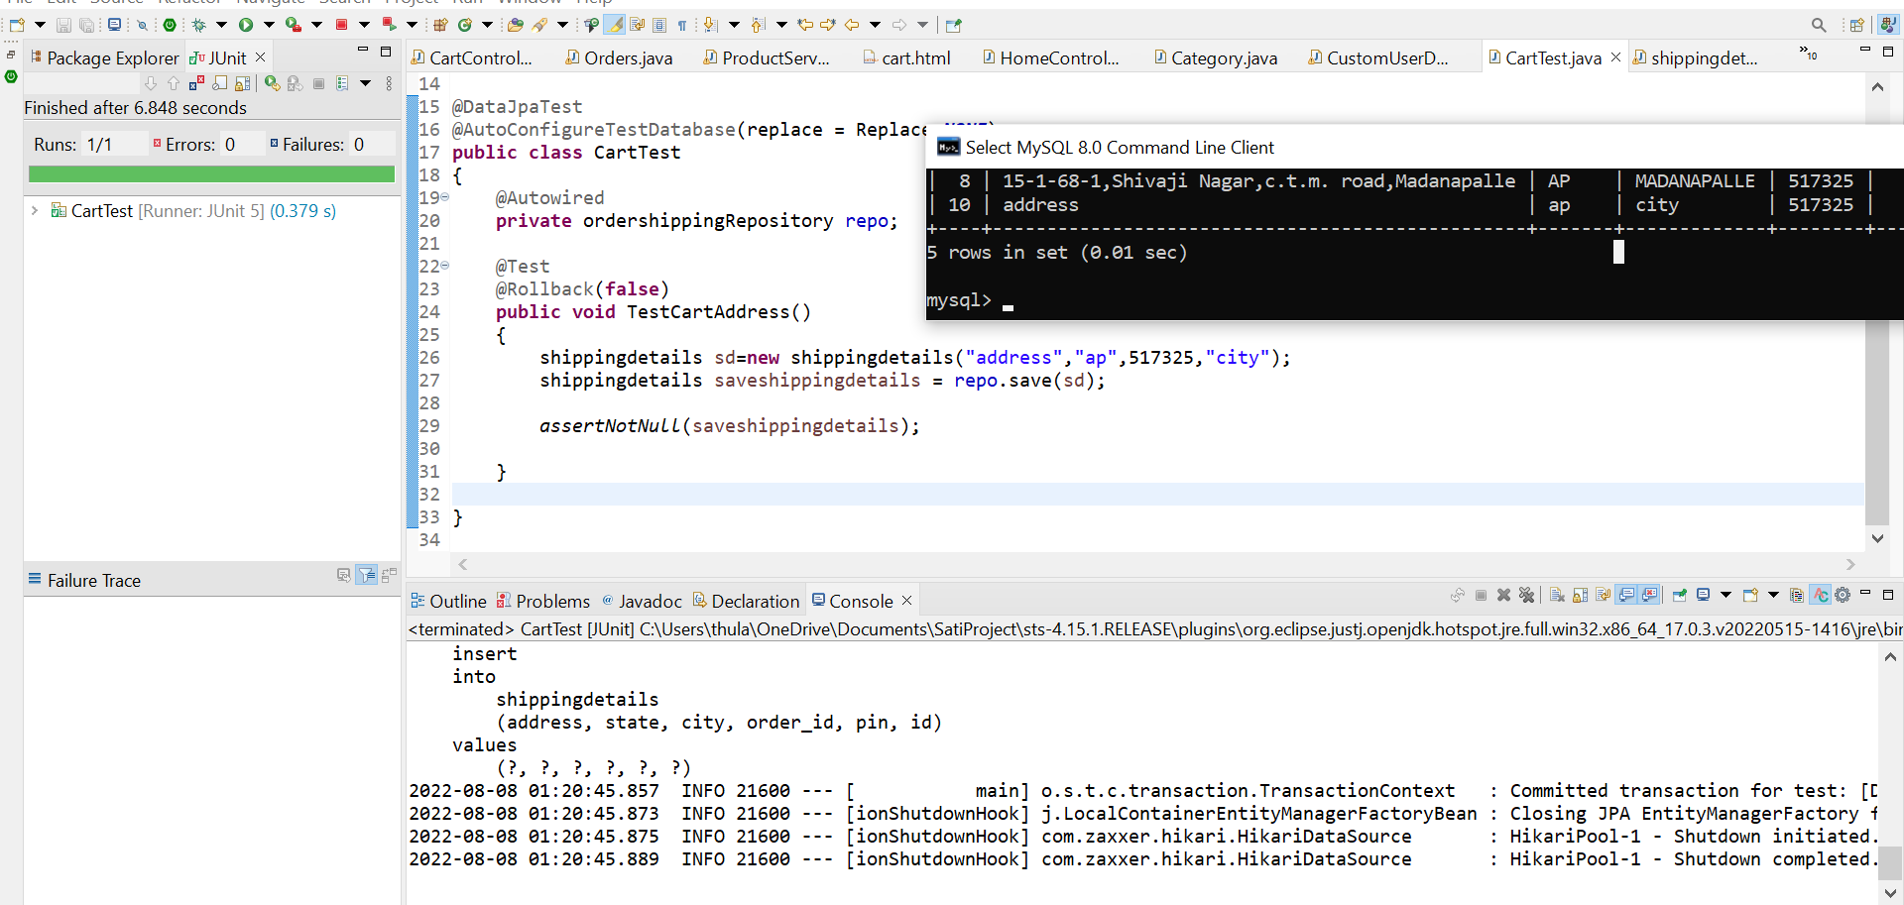
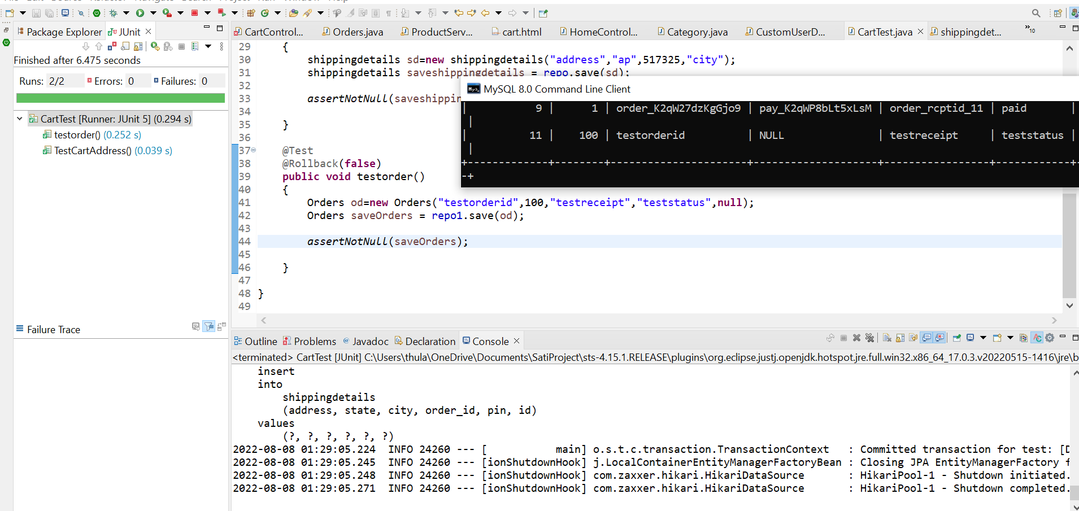
Continued.. Junit Testing Screeshot

Slide 17
Features about the module
User friendly Interface
Razorpay Payment Integration
User can use any payment method
User can view order Details Right After Payment Done

Slide 18
Future enhancement
To add Sell product option, where user will also be able to sell their own products.
Add more Single Sign On links like facebook, twitter, etc.
Include stock management.
User profile including orders history.

Slide 19
Quality improvement task
The approached Testing concepts
->JUnit
DevOps tools approach
->MySQL
->Maven
->GitHub
UI approach
->HTML
->CSS
->BootStrap
->JavaScript

Slide 20
Conclusion
In this project we have built an ecommerce website specially designed for automotive parts. With online payment and may more facilities.Which has user friendly interface for easy use purpose.
We have implemented the CRUD operations with hibernate and spring boot for easy use of the project.
With this we conclude that this project has almost fulfilled all the basic necessities of an ecommerce website.

Slide 21

Presented By SateeswarBabu Katem

